Slide 1
Welcome

Slide 2
INTRODUCTION
Md.Hatem Ali (Asst : Teacher )
S.D.M
Khansama Dinajpur
Contuc :01720436221

Slide 3
Lesson Plan
Class : Nine ,Ten.
Subject : English 1st Paper
Section : Unit 05, lesson 02
Time : 50 minutes.

Slide 4
Our lesson is :---
ENVIRONMENTAL POLLUTION

Slide 5
FROM THIS LESSON WE WILL BE ABLE TO -------
Learn new vocabs
Causes of Environmental Pollution
Kinds of Environmental Pollution
Rules of using Modal Auxiliary Verbs.

Slide 6
Guess the meaning
Excessive
Undistinguishable
Become less
Indiscriminate
Lessen
Enormous

Slide 7
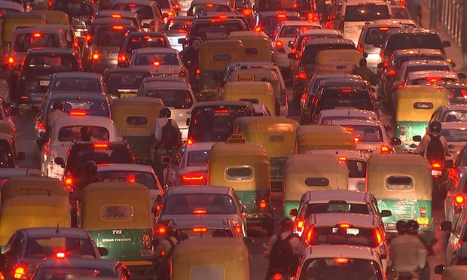
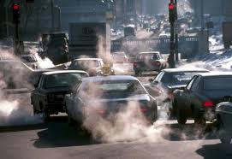
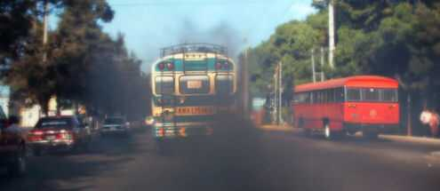
Sound is polluted by vichles’s horn
Air is polluted by smoke from vichles.

Slide 8
Pair Work
How water is polluted?
Water is polluted ………..
By throwing industrial waste materials in the ponds, canals, river etc.
By throwing chemical in the field.
If we bath our animals into the pond, canals, river etc.

Slide 9
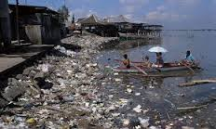
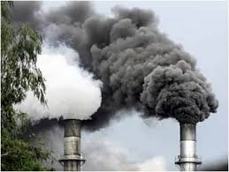
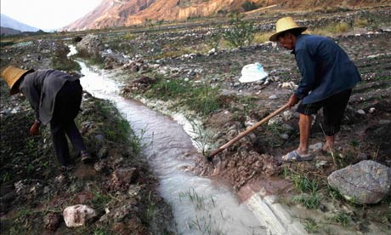
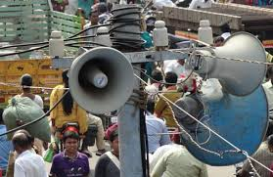
Kinds of Environmental Pollution
Water Pollution
Air Pollution
Soil Pollution
Sound Pollution

Slide 10
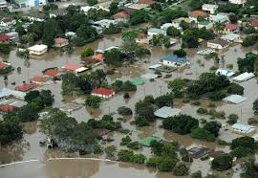
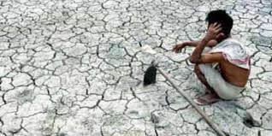
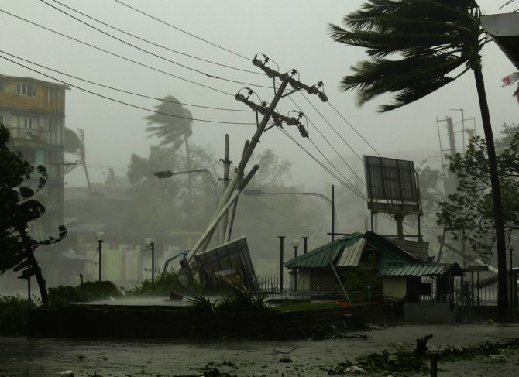
Effect of Environmental Pollution
Draught
Cyclone
Flood

Slide 11
Complete the text---
Group Work
Pollution | Causes | Suggestions
Air Pollution | Toxic smokes from industrial plants Smoke from the brick fields | Don’t drive motorcars which are older than 20 years
Soil Pollution | Use of agricultural pesticides and fertilizers | Plant more trees to help prevent loss of fertility in the topsoil

Slide 12
Evaluation
How our environment is polluting day by day?
What are their effect on human being?
How we can save our environment?

Slide 13
Name of the Grammar Point
MODAL AUXILIARIES
Examples:
Environmental Pollution may occur in many ways.
Water pollution can occur in occans, rivers etc.
Natural fertilizers and compost can be
used by men. (Passive style)
Form : Subject + Modal Auxiliaries + Present form of main verb + others
Each group write down 03 sentences using modal auxiliaries in your note book

Slide 14
HOME WORK
Write a paragraph about water pollution.

Slide 15
THANK YOU

